Slide 1

The Machine Learning Process
How do I select a pandas Series from a DataFrame?
Dr. Reza Dibaj

Slide 2
Basic Object Types in pandas
There are two basic object types in pandas:
DataFrame: A table of rows and columns
Series: Each of the DataFrame columns
Mostly, we work with Series that are part of a DataFrame.
Question:
How do we select a Series from a DataFrame?
Notes:
Why we need to select a Series?
Do an analysis
Manipulate that Series

Slide 3
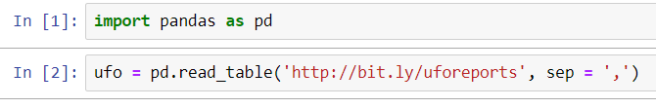
Welcome to jupyter….
First, we import pandas as always in a conventional way.
Then using a UFO reports from 1930 to 2000.
Please notice that as our dataset uses comma to separate its fields, we need to mention the sep = ',' to notify the separator.
Point: Table is a tab separated file in nature.
Notes:
import pandas as pd
ufo = pd.read_table('http://bit.ly/uforeports', sep = ',')

Slide 4
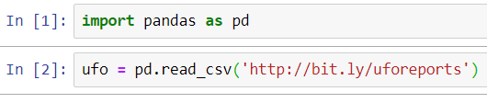
Question for Reza…
Q: Is there any alternative that knows comma-separated value files and we do not need to mention the comma separator?
R: Yes! Read_csv which by default uses comma as the default separator.
Notes:
import pandas as pd
ufo = pd.read_csv('http://bit.ly/uforeports’)

Slide 5
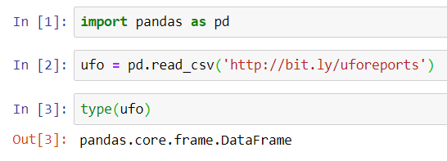
Confirm the DataFrame Type
If you want to check the type of ufo DataFrame, you type the following command:
Point: type is a built-in Python method to retrieve the object type
Notes:
import pandas as pd
ufo = pd.read_csv('http://bit.ly/uforeports’)
type(ufo)

Slide 6
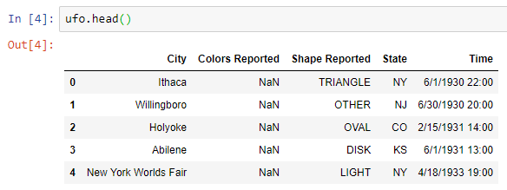
Checking the results so far
To check the result of the process, we simply use the head() method as follows:
Notes:
import pandas as pd
ufo = pd.read_csv('http://bit.ly/uforeports’)
type(ufo)
ufo.head()

Slide 7
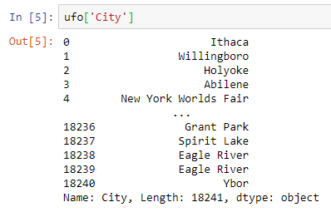
How two select a Series….
The standard way to select a Series is using brackets.
Notes:
import pandas as pd
ufo = pd.read_csv('http://bit.ly/uforeports’)
type(ufo)
ufo.head()
ufo['City']

Slide 8
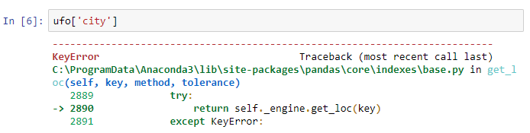
Question for Reza…
Q: Reza! I just did as you said, but I received the following error!
R: Guys! Please help your team member! I have no clue where the problem is…
Notes:
Yes! You are right! Python is seriously case-sensitive….

Slide 9
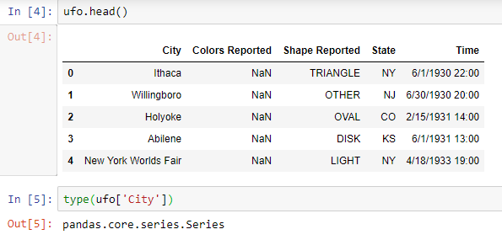
Confirming the Series Type
Please try the following line to see the type of the Series…
Notes:
import pandas as pd
ufo = pd.read_csv('http://bit.ly/uforeports’)
type(ufo)
ufo.head()
ufo['City’]
type(ufo['City'])

Slide 10

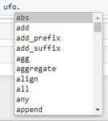
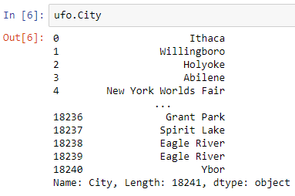
One shortcut for retrieving a Series
When we load a dataset into our DataFrame, every column-header would become an attribute of that DataFrame, so we can access it, using a DOT.
You can simply type ufo. And then press the Tab button to see the columns and methods.
We call this approach as Dot Notation.
Notes:
import pandas as pd
ufo = pd.read_csv('http://bit.ly/uforeports’)
type(ufo)
ufo.head()
ufo['City’]
ufo.City

Slide 11
Exceptions for the Shortcut Method
In any of the following conditions, we must use brackets:
If a column that we want to access is the same as a method name or attributes, such as head()
If the column name has two separate words, such as Colors Reported

Slide 12



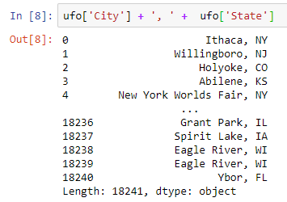
Bonus Tip
How to create a pandas Series in a DataFrame?
Notes:
ufo['City'] + ', ' + ufo['State']

Slide 13
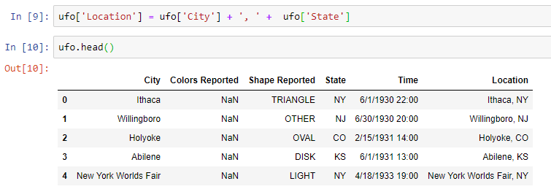
Bonus Tip
Now, we create a column, named Location, which contains the City and the State that we concatenated in the previous slide.
Notes:
ufo['Location'] = ufo['City'] + ', ' + ufo['State’]
ufo.head()
Note:
Ufo.'Location’ Does not work!

Slide 14

Thank you
Question?
To be
Not to be

